Slide 1
The Dweller Left Adrift
By James Kawashima

Slide 2
What is this Game?
This game is a Metroidvania that takes place within a mystical forest where a lone soldier who has been taken captive must explore through the vast lands of this forest while fighting, solving puzzles and encountering people along the way in order to escape from their captors so they can reunite with their tribe.

Slide 3
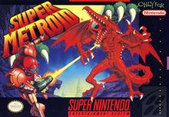
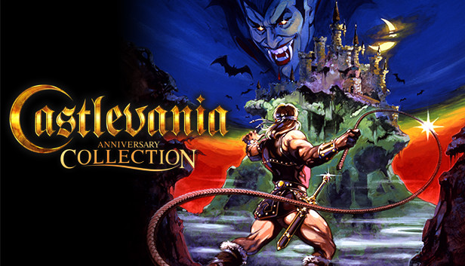
What is a Metroidvania?
Metroidvania games are a subgenre of Action-Adventure platformer games, named after its two first well-known franchises, Metroid and Castlevania.
Metroid
Castlevania

Slide 4
Metroidvania:
Features large interconnected world maps the player can explore, but access to parts of the world is limited by doors or other obstacles that can only be opened after the player has acquired special tools, weapons or abilities within the game.
Acquiring such improvements also aids the player in defeating more difficult enemies and locating shortcuts and secret areas, and often includes retracing one's steps across the map.
Metroidvania's usually do not consist of any linear gameplay and often involve much backtracking - especially after new powerups or tools have been obtained allowing the player to feel a sense of free exploration while still having a consistent narrative.

Slide 5
Action-Adventure:
Featuring long-term obstacles that must be overcome using a tool or item as leverage (which is collected earlier), as well as many smaller obstacles almost constantly in the way, that require elements of action games to overcome.
Action-adventure games tend to focus on exploration and usually involve item gathering, simple puzzle solving, and combat.
Hollow Knight

Slide 6
Platformer:
- Using navigation such as going through areas; thus navigating using movement such as walking, climbing, jumping in order to explore.
- The player is offered a lot of control over the actions that the character performs within the game.
- Puzzles can be made centered around the moving mechanics.
- Settings tend to be vertically exaggerated with much uneven terrain that the player can leap up to or fall off of.
Ori and the Blind Forest

Slide 7
Art Style:
The art style will most likely be in a pixel art format since it I like how it looks + it is faster for me at least to animate with pixel art.

Slide 8
World Building:
- This game takes place in a secluded forest that has been hidden away for many centuries.
- Within this forest lies many different living organisms such as insects, plants, and mushrooms who are all anthropomorphic meaning that they have human like traits such as speech, thought and other human attributes like physical traits as well.
- Given that these characters are all sort-of human like individuals they are seen within the world to build houses for shelters and have their own towns and civilizations.
- Throughout time, this forest has remained peaceful until a mysterious happenstance created chaos within the forest laying siege to many events to come such as the deterioration of the forests health and building high tensions between the many factions.

Slide 9
- This game takes place after pandemonium that ensued.
- The great war between the mushrooms and the insects was a devastating war for both parties, many were killed and captured in order to claim as much territory over the other since resources were scarce once the forest started dying.

Slide 10
Story:
Maya is a soldier from the mushroom tribe and is separated from her people after becoming hostage of the ant colonies.
She escapes and is on a mission to get back to her tribe; but in order to do so she must escape the Ant colonies city and venture forth through the decaying forest in order to return to the Mycelium network of her tribe.
The forest is in disarray so there are many obstacles such as puzzles, traps and foes preventing her from accomplishing her goal so she must succeed and overcoming them if she wishes to reunite with her tribe.

Slide 11
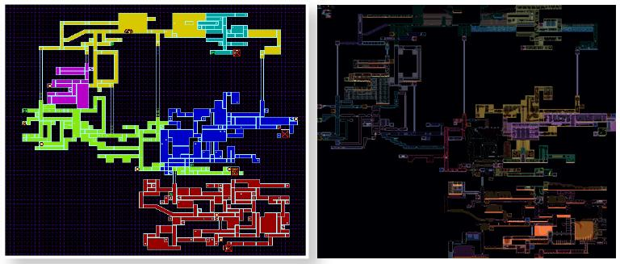
Game Map
The maps within the game will be 2d world that are in a side to side areas that are best represented by sections like the map from Super Metroid.

Slide 12
Characters:
Maya - The protagonist of this video game
Ant Guards - Main enemies within the game.
Antenant - The one who imprisons Maya.
Ludo - A captive of the ant colony that helps Maya escape.
Takeshi - The wise hermit that resides within the dying forest who provides Maya with a place to stay and a key to access an area.
Others to come throughout development.

Slide 13
People I would want for the project:
Anyone one that is actually inclined to work on this project and put effort into it.
People that can do art and music would be nice but not necessary since I can fit those roles if need be.

Slide 14
Inspirations:
Games:
Metroid Series
Hollow knight
Dead Cells
Hyperlight Drifter
Ori and the Blind Forest
Moonlighter
Bug Fables
Shows:
My neighbor Tottoro
Hilda
Nausicaä of the Valley of the Wind
People:
Some of my best friends for being obsessed with the mushroom aesthetic.

Slide 15
Sources:
https://www.canadiangeographic.ca/article/inside-intricate-world-video-game-cartography
https://en.wikipedia.org/wiki/List_of_video_game_genres#cite_note-adams2013-c3s2-2
https://i.pinimg.com/474x/b9/cd/5b/b9cd5b5fd5c010b8ddb20bc5ceb41af5.jpg
https://thumbs.gfycat.com/UnluckyHairyCapeghostfrog-size_restricted.gif
https://cangeo-media-library.s3.amazonaws.com/s3fs-public/images/web_articles/supermetroidmaps_0.jpg
https://rectifygaming.com/wp-content/uploads/2020/03/Ori-Blind-forest-platforming-gif.gif
https://pa1.narvii.com/6608/f8e69420e196a8b9559c5d884b11cb92159205bc_hq.gif

